Slide 1

Sentiment analysis of Movie Reviews
Aviv Shimoni & Linoy Valko

Slide 2

Table of contents
01
02
03
05
06
07
04
Purpose
Motivation
Methods & Tools
Methodology
08
Evaluation
Visualization & Analysis
Conclusions
Further Research

Slide 3

01
Purposes
Analyze movie reviews to determine the sentiment expressed by audiences.
Present the features that determine the sentiment classification.

Slide 4

02
Motivation
Rich Data Source- Movie reviews provide a large and diverse pool of text data.
Understand Audience Reactions- Uncover patterns and trends in how audiences feel about movies.
Predict Movie Success- Use insights to make better predictions about a movie’s performance.
Practical Applications- Help with marketing strategies, improve recommendation systems, and guide filmmakers to create popular content.

Slide 5

03
Methods & Tools
Convert text into numerical features using techniques like:
Bag of Words: Counts the frequency of words.
TF-IDF: Weighs words based on their importance.
Word Embeddings: Represents words as vectors using models like Word2Vec, GloVe.
Classify sentiment using:
Supervised Learning: Train models using labeled data with algorithms like Logistic Regression, SVM or Naive Bayes.
Deep Learning: Use neural networks such as RNNs, LSTM, or CNNs for more complex patterns.
Pre-trained Models: Utilize models like BERT, GPT.

Slide 6


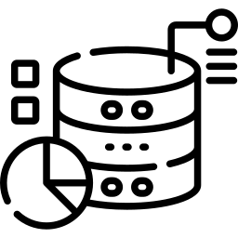
Methodology
04
Data Collection
IMDB Dataset
50,000X2
Data Preprocessing
HTML tags removal
Convert text to lowercase
Stop words removal
Feature Extraction
TF-IDF
Sentiment Classification
Supervised Learning using Logistic Regression
Evaluation
Using Accuracy, Recall and Precision
Visualizations & Analysis
Using graphs and charts

Slide 7
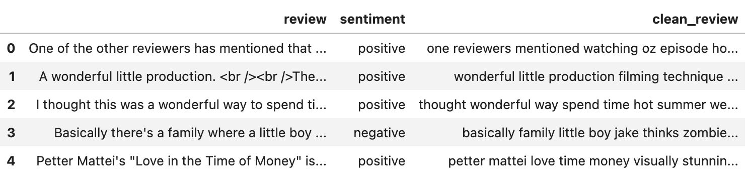
04
Methodology- Dataset
50,000X3

Slide 8
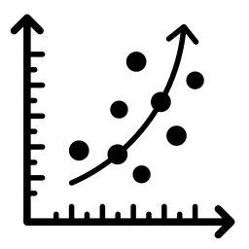
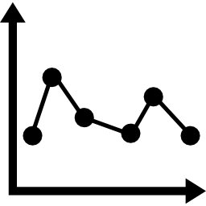

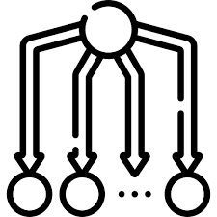
Methodology- Model Comparison
04
Train-80%
Test- 20%
Logistic Regression (c:1, penalty: ‘l2’, solver: ‘saga’)
Accuracy- 89.3%
Linear SVM (c:0.05, penalty: ‘l2’)
Accuracy- 88.9%
Random Forest (max_depht: 500, n_estimators: 200)
Accuracy- 85.7%
Naïve Bayes (alpha: 5)
Accuracy- 85.6%

Slide 9
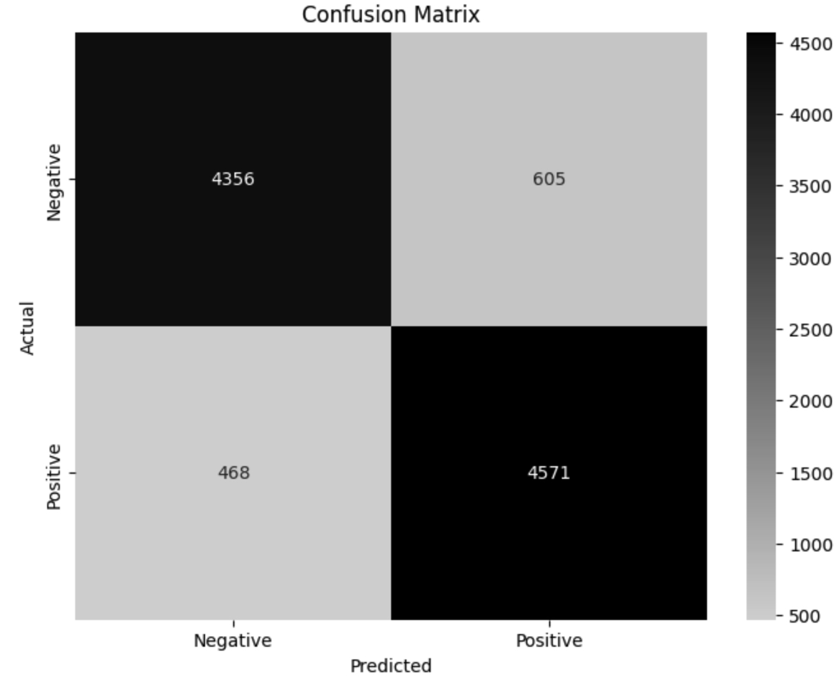


Evaluation
05
01
02
03
Accuracy
Recall
Precision
89.3%
90.7%
88.3%
Logistic Regression

Slide 10
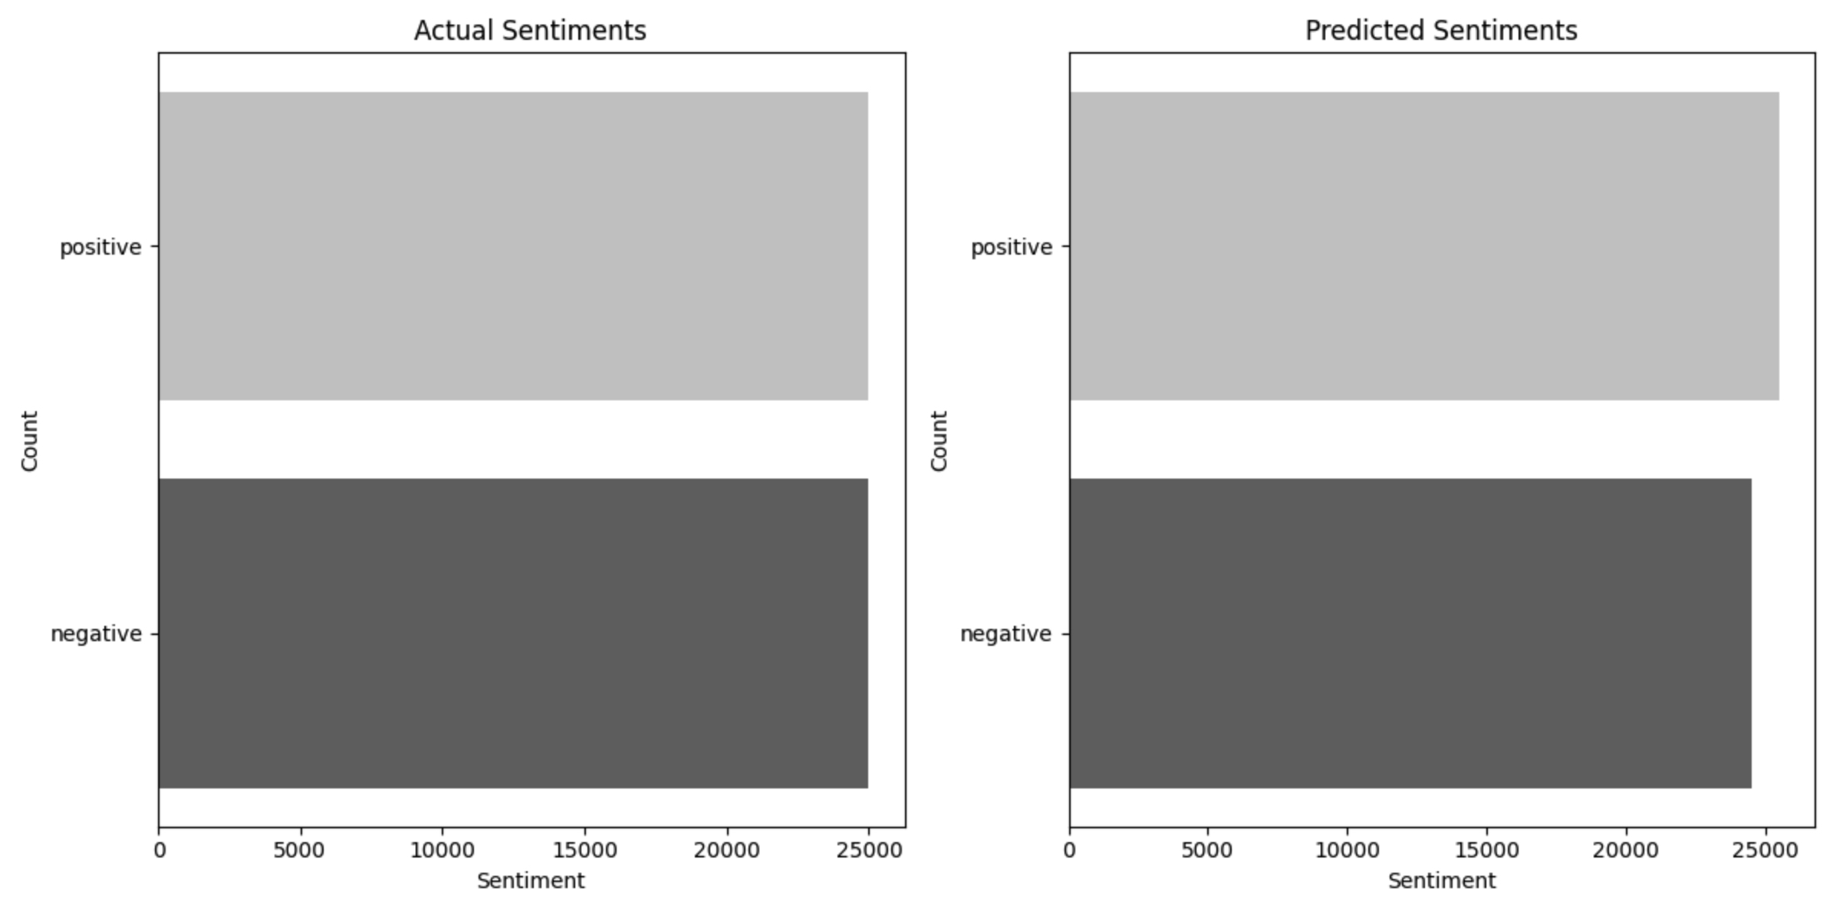
Methodology- Evaluation
05
The database is balanced.
The model tends to predict more positive than negative reviews.

Slide 11
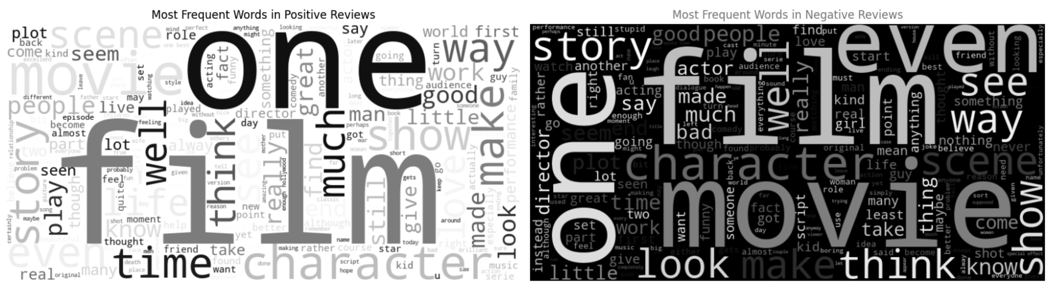
Visualizations & Analysis
06
Most Frequent Words in Positive Reviews
Most Frequent Words in Negative Reviews

Slide 12
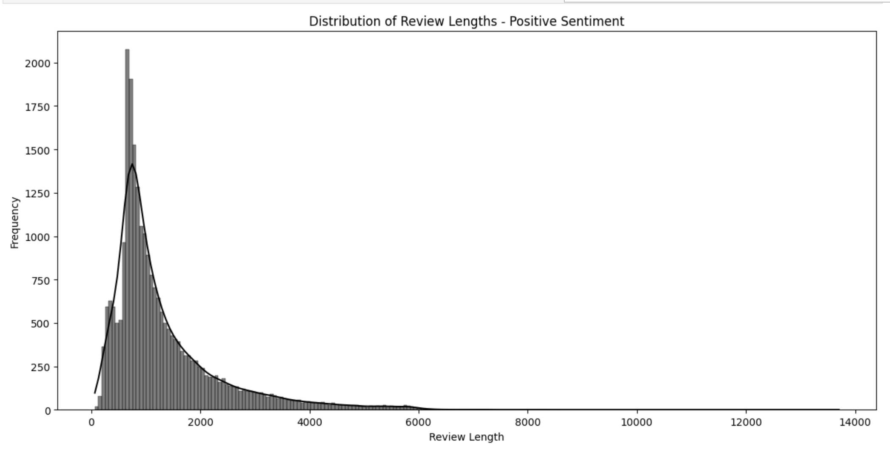
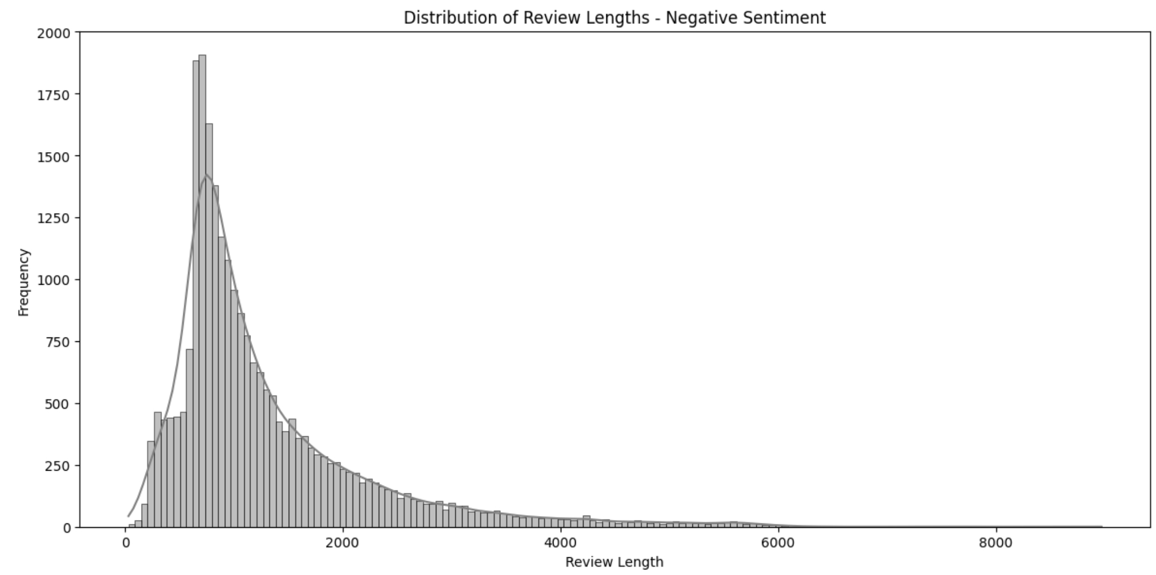
Positive reviews tend to be shorter than negative reviews.
Most reviews for both sentiments are relatively short, with the highest frequencies occurring below 1000 characters.

Slide 13
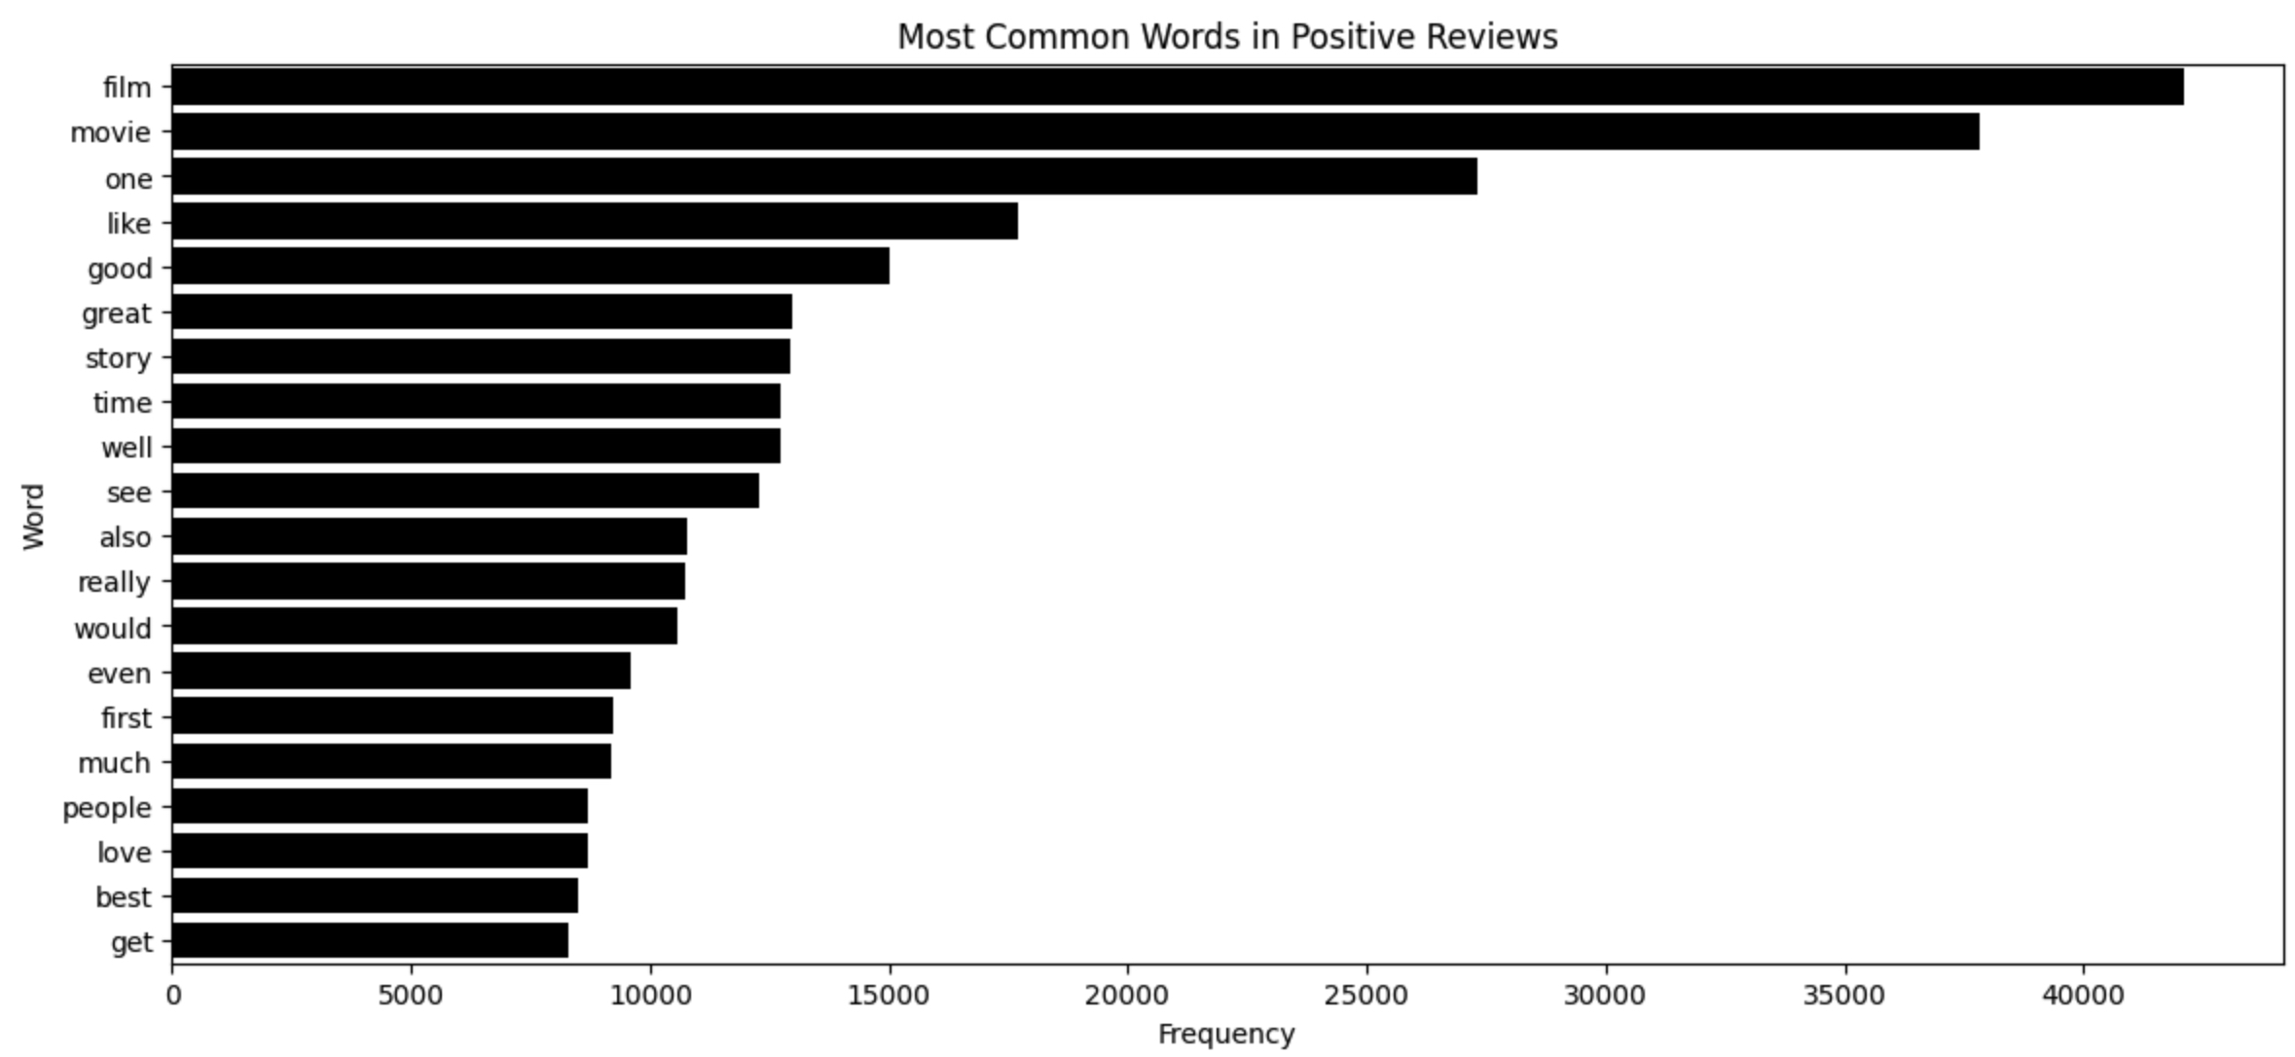
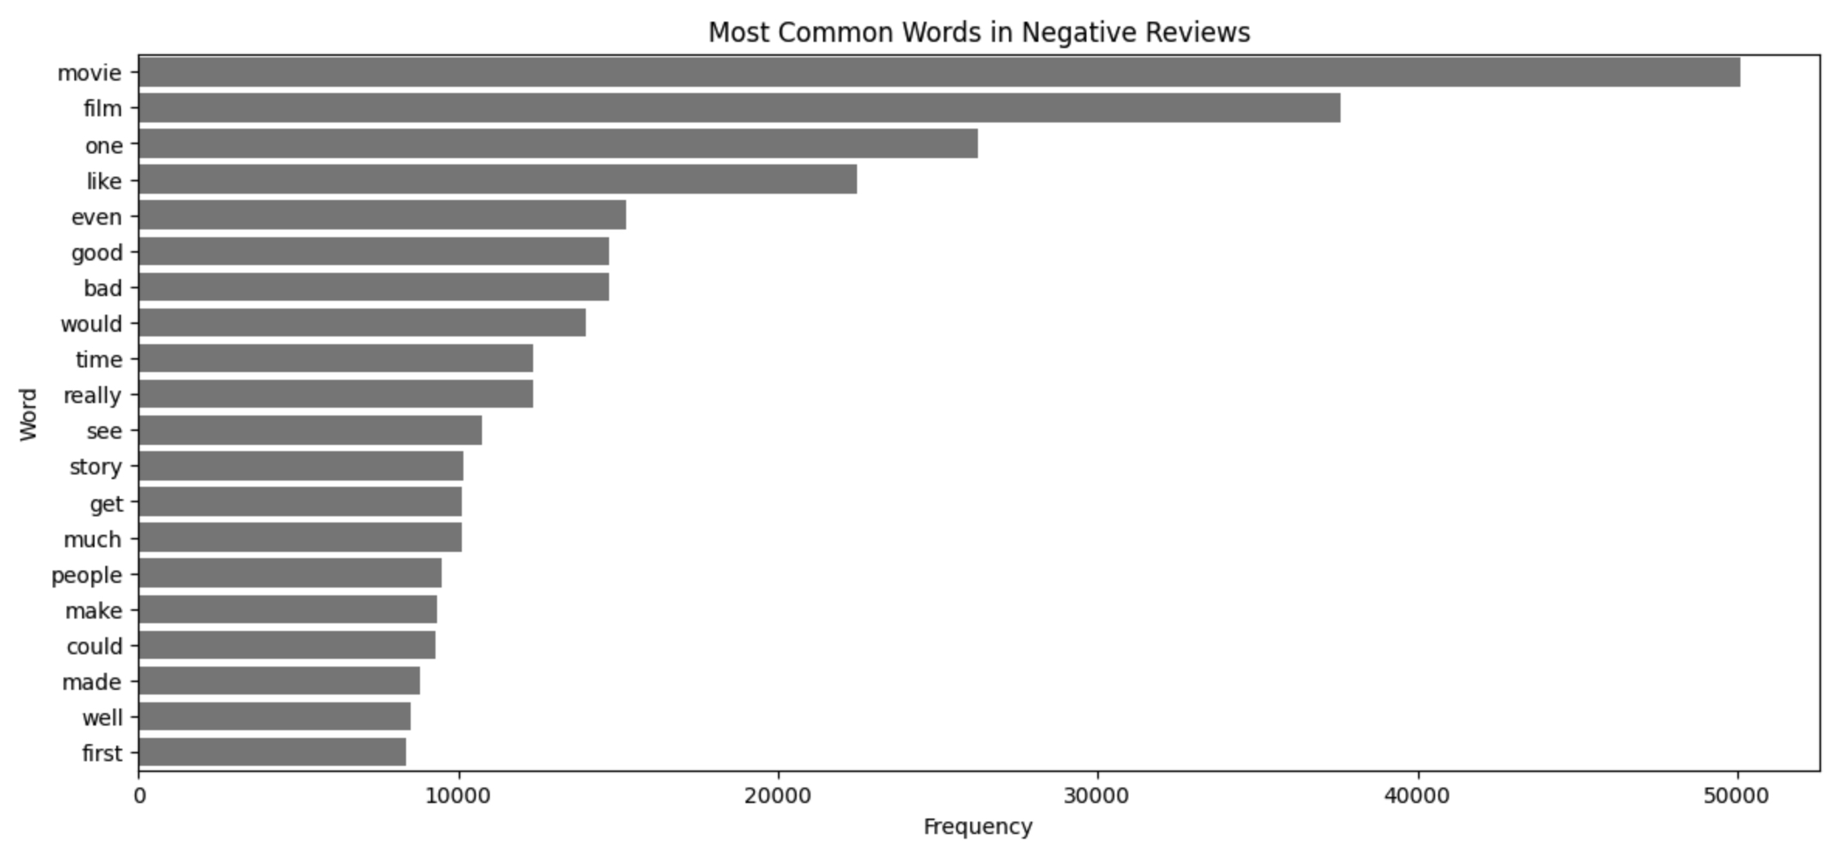
Common positive words include "one", "like", "good", and "great".
Negative reviews uniquely include "bad" in their top words but also “good”.

Slide 14
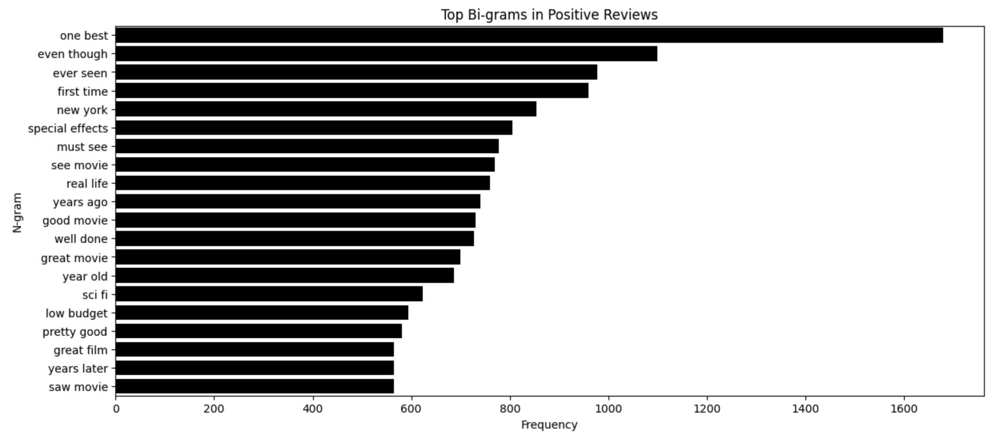
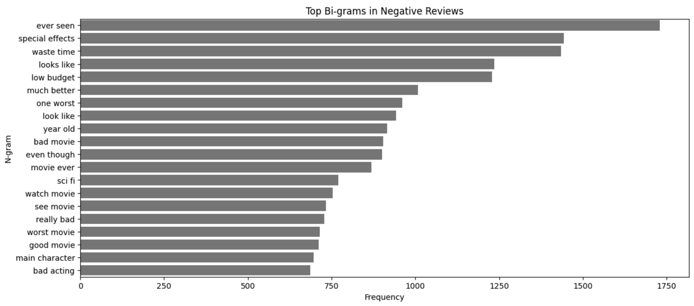
Common positive bi-grams include “one best”, "even though", "ever seen", "first time", and "new york".
Negative-sentiment phrases like “ever seen”, "Special effects" and "waste time”.

Slide 15
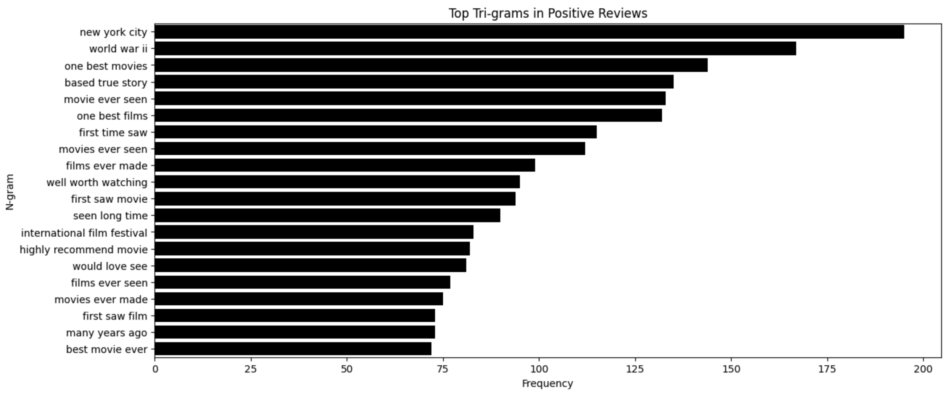
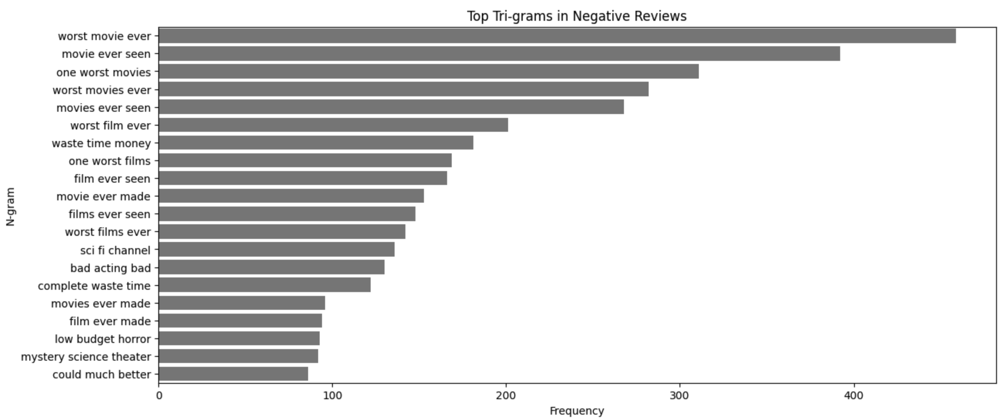
"New york city" is the most frequent tri-gram. Other frequent positive tri-grams include "one best movies", "based true story", and "movie ever seen".
"Worst movie ever" is by far the most frequent tri-gram. Other common negative tri-grams include "movie ever seen", "one worst movies", and "worst movies ever".

Slide 16
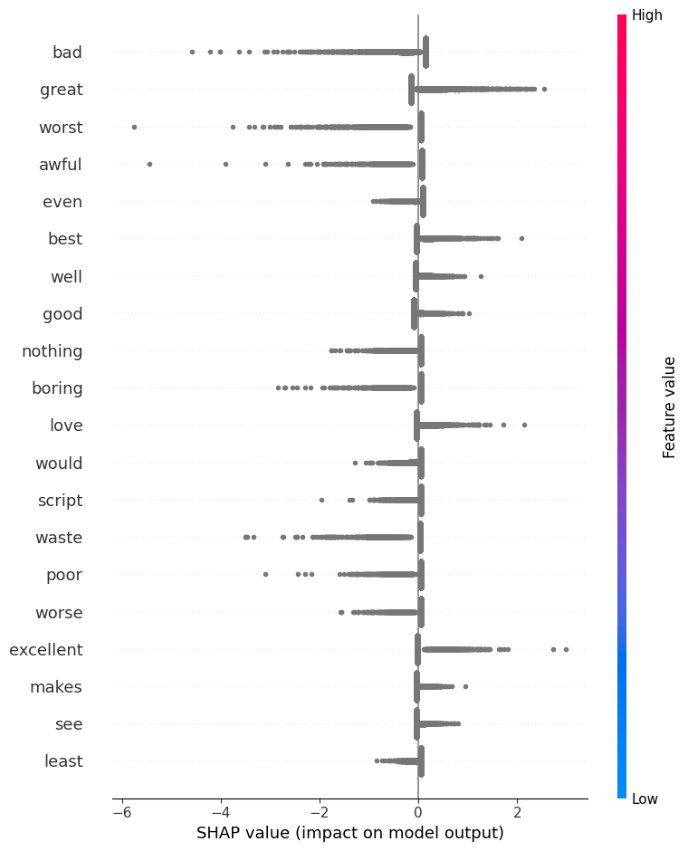
The magnitude of SHAP values indicates the importance of features (words).
Words like "bad" and "great" showing the highest impact among the features listed.

Slide 17
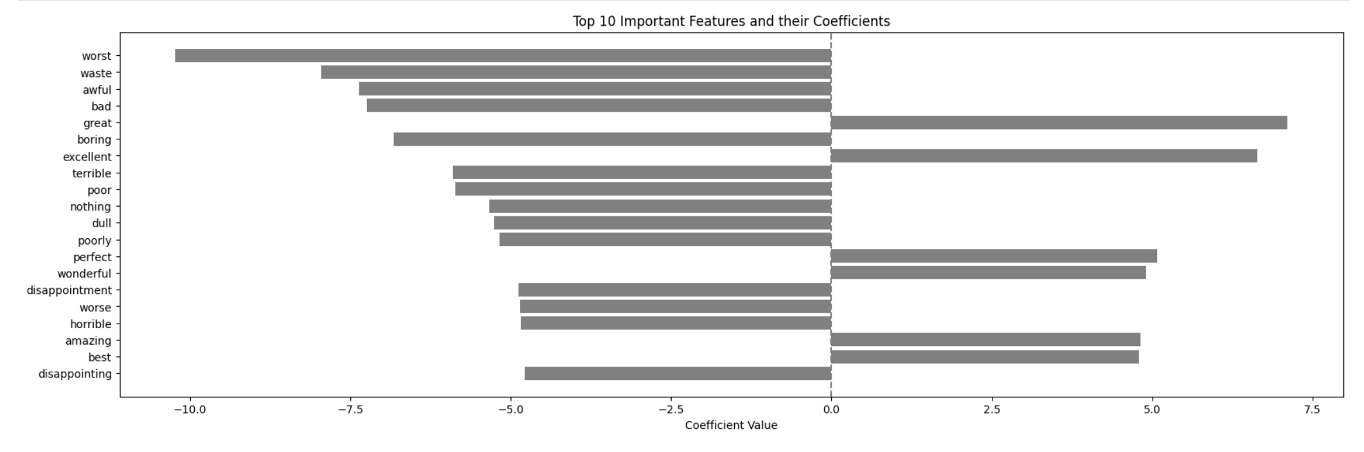
The model or analysis may be more sensitive to negative sentiment. It has a wider vocabulary for detecting negative opinions or experiences.

Slide 18
Conclusions
07
Logistic Regression delivered the best performance
Bigrams and trigrams capture word pairs and triplets, which help in understanding the sentiment context better than single words
There are more short reviews than long ones in both sentiments
The model is more sensitive to negative reviews
The sentiment classification model shows good accuracy in predicting sentiments, as evidenced by the close match between actual and predicted sentiments.
The context in which words and phrases are used is crucial.

Slide 19


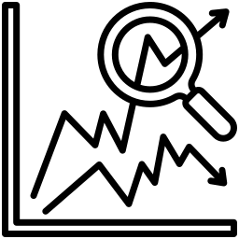

What’s next?
08
Experiments
Rating System
Conduct experiments with datasets of negative, positive, and neutral reviews
Develop a movie rating system based on reviews
Trend Analysis
Contextual Analysis:
Study sentiment trends over time and their correlation with movie popularity
Investigate the role of contextual information in sentiment analysis

Slide 20


Thanks!

